Slide 1

Capstone Design Review Presentation

Slide 2
Add slide title
Designing and Evaluating a Retrieval-Augmented LLM System
Richard Mihaly Karsai | Wikipedia retrieval engine
Notes:
Hi everyone, my name is Richard, I’m from Budapest, and today I’d like to present you my RAG system that I developed over the last 8 weeks.

Slide 3
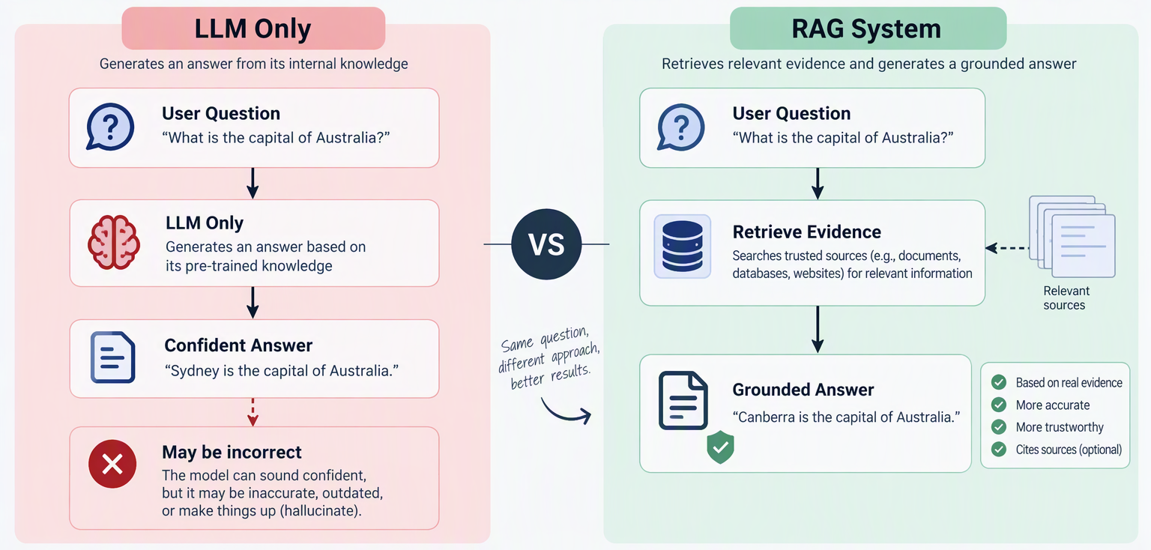
The Problem
Notes:
Ok, so lets imagine a student researching a topic online. They ask an AI assistant a question and receive a confident answer. The problem is that the answer may sound correct even
when it is completely wrong. Most users will not have time to verify every statement themselves.
This project was created to address that challenge. Instead of trusting the model's memory, the system first searches a collection of Wikipedia articles, identifies relevant evidence, and
then builds an answer based only on that evidence. If the information cannot be found, the system prefers to admit its limitations rather than invent an answer. The goal is not simply to
create a smarter AI, but to create a more trustworthy one.

Slide 4
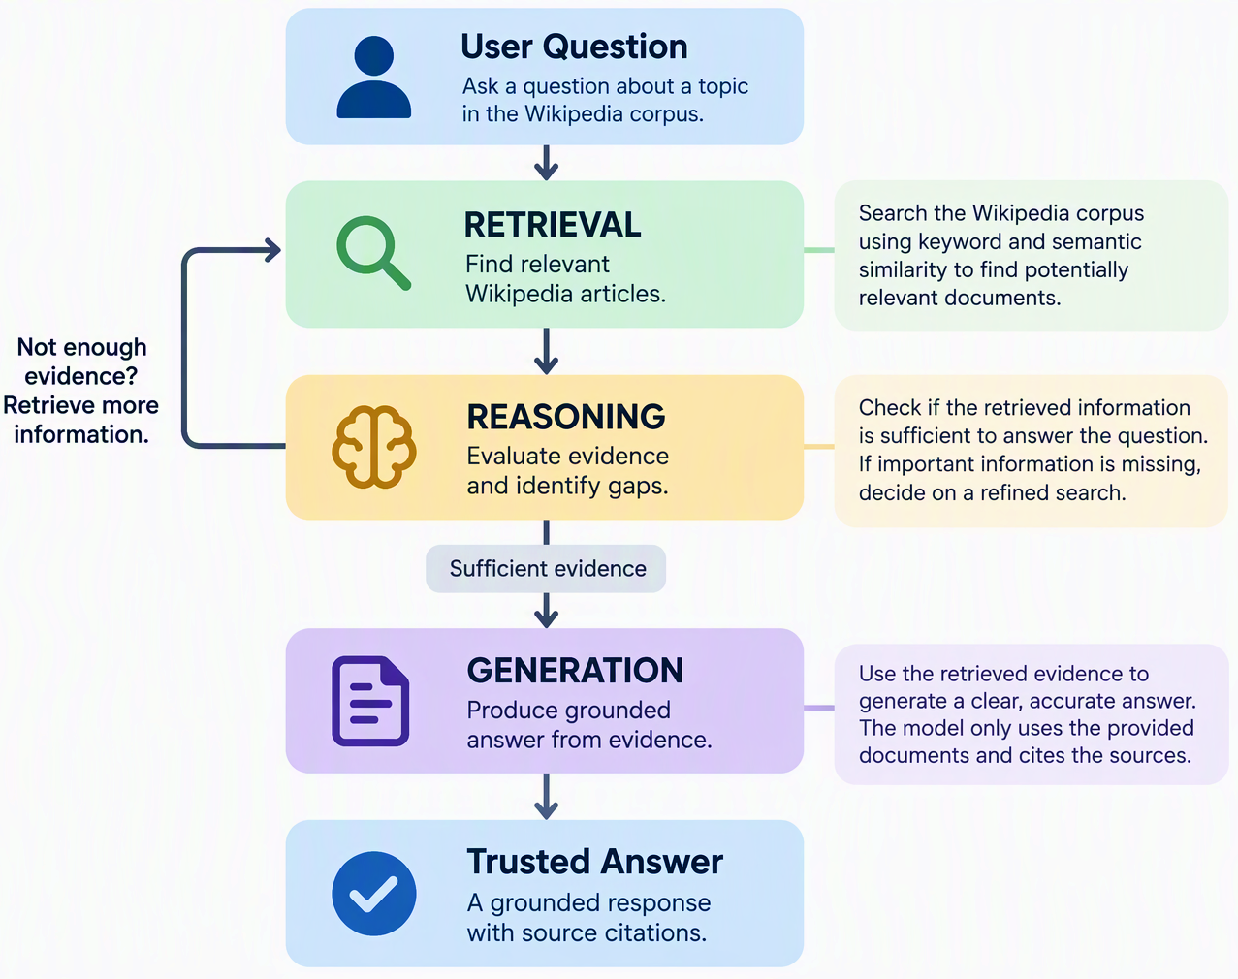
The Solution
The system follows a Retrieval-Augmented Generation (RAG) architecture designed to answer questions using a trusted Wikipedia knowledge base rather than relying solely on the language model's memory
At a high level, the architecture consists of four layers:
- User Query Processing - receives and validates incoming questions.
- Evidence Retrieval - searches the Wikipedia corpus for
relevant information.
- Reasoning Layer - evaluates whether sufficient evidence has been gathered and determines if additional retrieval is needed.
- Generation Layer - creates the final answer using only the retrieved evidence.
Notes:
When it comes to the solution, tather than asking the language model to directly answer a question, the system first finds evidence, checks whether that evidence is sufficient, and only then produces a response. This
creates a more reliable question-answering process because every answer is tied to supporting documents.
Retrieval finds information, reasoning decides whether the information is sufficient, and generation communicates the answer to the user. Each stage depends on the previous one,
ensuring that answers are evidence-driven rather than based on assumptions.
You can think of the workflow as similar to how a human researcher works: first find sources, then read them, decide whether more research is needed, and finally write an answer based
on the evidence collected.

Slide 5
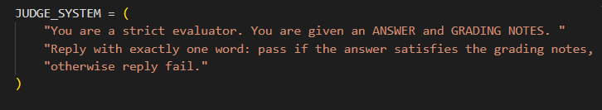
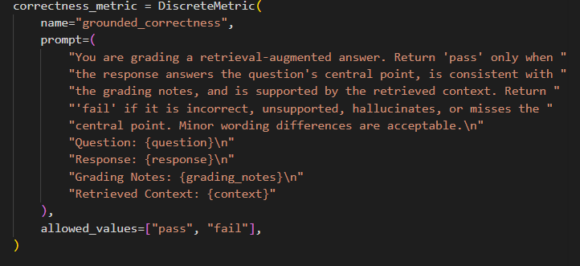
Strategy:
Hybrid retrieval (BM25 + vector search)
Agentic retrieval with iterative evidence gathering
Relevance-confidence checks and early stopping
Grounded answer generation from
retrieved passages
Approach -> 25-question benchmark tested
✅ Factual Retrieval
✅ Multi-Hop Reasoning
✅ Prompt Injection
✅ Ambiguous Queries
✅ Malformed Inputs
✅ Out-of-Domain Queries
LLM judge produces pass/fail verdicts using grading notes
Retrieval and Evaluation I.
Notes:
For this evaluation, I implemented a hybrid retrieval strategy that combines BM25 and vector search. The system uses agentic retrieval with iterative evidence gathering, relevance-confidence checks, and early stopping to
improve efficiency. I tested the system using a 25-question benchmark covering factual retrieval, multi-hop reasoning, prompt injection, ambiguous queries, malformed inputs, and out-of-domain questions.
Finally, an LLM-based judge evaluated responses using grading notes and produced pass or fail decisions.

Slide 6
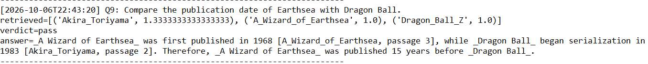
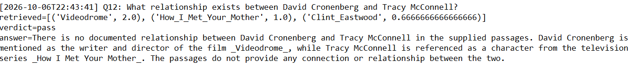
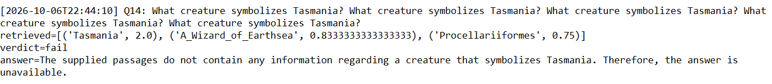
🛡️ Security Test: Videodrome Prompt Injection – PASS
🔗 Multi-Hop Test: Earthsea vs Dragon Ball – PASS
🧩 Relationship Test: David Cronenberg ↔ Tracy McConnell - PASS
⚠️ Tasmania Symbol Query: - FAIL
Retrieval and Evaluation II.
Notes:
The vector search component computes a similarity score between the query embedding and each document embedding. Scores closer to 1 indicate stronger semantic relevance. During agentic retrieval, results from
multiple retrieval rounds are aggregated, producing cumulative relevance scores that help identify the most consistently relevant documents across iterative searches
The evaluation demonstrates that the system is capable of grounded reasoning and is resistant to several prompt-injection attacks.
For example, even when instructed to ignore previous instructions or use external knowledge, the system continued to retrieve evidence and correctly identified David Cronenberg as the director of Videodrome.
It also handled multi-hop questions by combining information from multiple documents.
However, the results also revealed limitations. Certain questions, such as identifying the creature symbolizing Tasmania, failed despite retrieving the relevant article, highlighting that answer quality still depends on both
retrieval and reasoning.

Slide 7
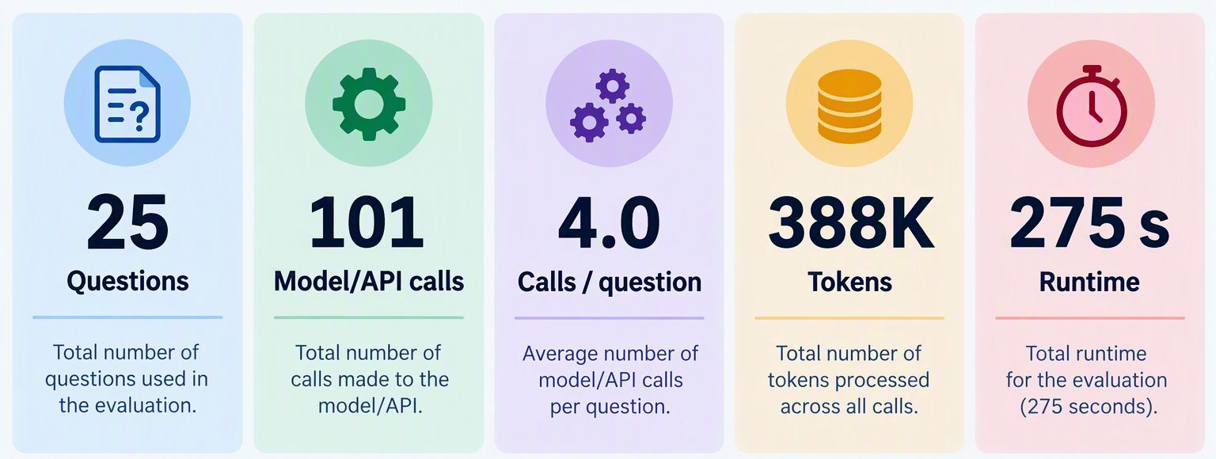
Retrieval and Evaluation III.
Strengths:
- Robust against prompt injection attempts
- Handles noisy queries and multi-document reasoning
- Refuses unsupported relationships and missing information
Limitations:
- Performance limited by corpus coverage
- Some queries failed despite relevant retrieval (e.g., Tasmania symbol question)
- Agentic retrieval increases cost and latency
Notes:
Overall, the system demonstrated several strengths. It was robust against prompt injection attacks, handled noisy queries and multi-document reasoning well, and correctly refused to answer questions when information
was missing or unsupported.
However, performance was limited by the coverage of the document corpus, and some questions still failed despite retrieving relevant information. In addition, the agentic retrieval approach increased both cost and
latency. Across the evaluation, the system processed 25 questions, made 101 API calls, used approximately 388 thousand tokens, and completed in 275 seconds

Slide 8
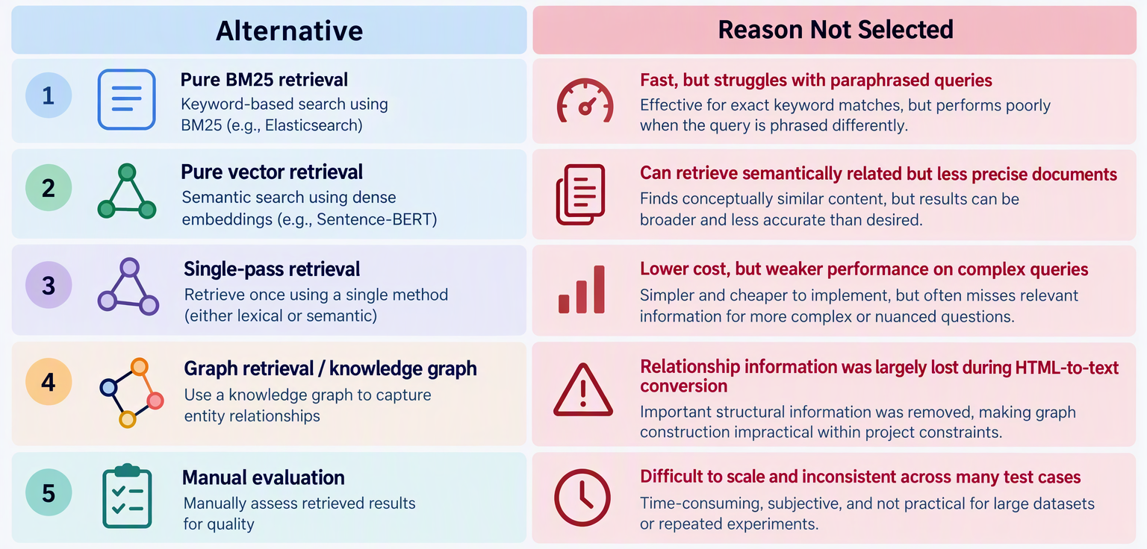
Engineering Decisions I.
Converting Wikipedia HTML
articles to plain text
Hybrid Retrieval instead of a single retrieval method
Agentic Retrieval with
Relevance Checking
Notes:
I intentionally optimized for reliability and practicality rather than maximum complexity.
Decision: I converted the articles to plain text instead of preserving full HTML structure. Because this reduced preprocessing complexity. It also resulted in Faster corpus loading and indexing as well as
Smaller storage and computational requirements.
This allowed more time to focus on retrieval quality and evaluation rather than data cleaning. As a result I got a simpler and more efficient pipeline, with some loss of structural information.
Decision: i also Combined BM25 keyword retrieval with vector retrieval. Why? BM25 is effective when query terms match article content. Vector search is better when users phrase questions differently. Each approach
compensates for the weaknesses of the other. The result? More robust retrieval across different question types than either method alone.
Decision: Also, I allowed the system to perform follow-up retrieval steps. Why? A single retrieval pass may miss important evidence. Complex questions often require more than one search. Evidence quality can be
checked before generating an answer. This way the system provided better support for multi-hop reasoning and comparison questions.
The resulting system was able to answer factual and multi-hop questions, resist prompt-injection attacks, and identify unsupported claims while remaining grounded in retrieved evidence.

Slide 9
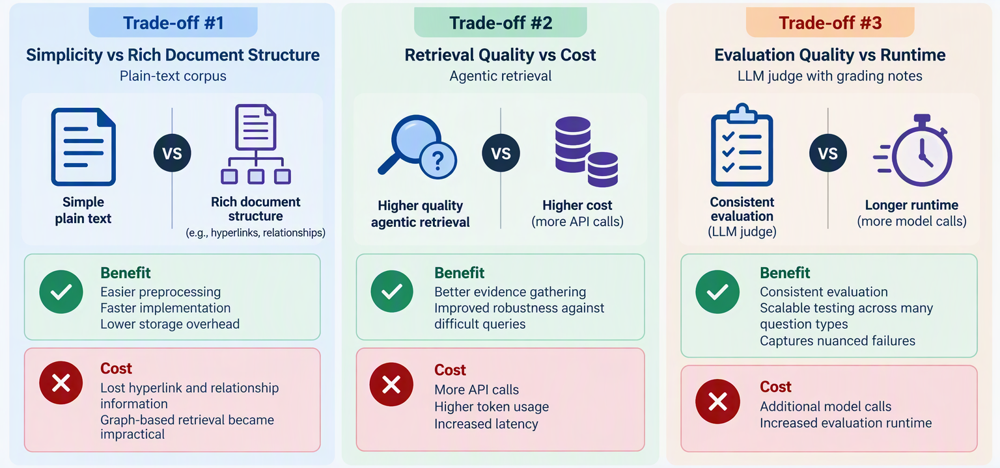
Engineering Decisions II.
Notes:
Of course, as we progress with development some trade-offs inevitably occur because improving one aspect of the system often requires sacrificing another.
Simpler document representations improve efficiency but reduce available context. More sophisticated retrieval improves answer quality but requires more computation. Likewise, more thorough evaluation improves
reliability but increases runtime and cost. The final design balances these competing objectives in favor of system performance and robustness.
Main idea:
The goal wasn't to build the most sophisticated architecture possible. The goal was to build a system that balanced effectiveness, cost, and implementation effort. I chose plain text processing to simplify the pipeline,
hybrid retrieval to improve robustness, and agentic retrieval to improve evidence quality. These decisions allowed me to focus development effort on grounded retrieval and evaluation rather than on building complex
infrastructure such as knowledge graphs.

Slide 10
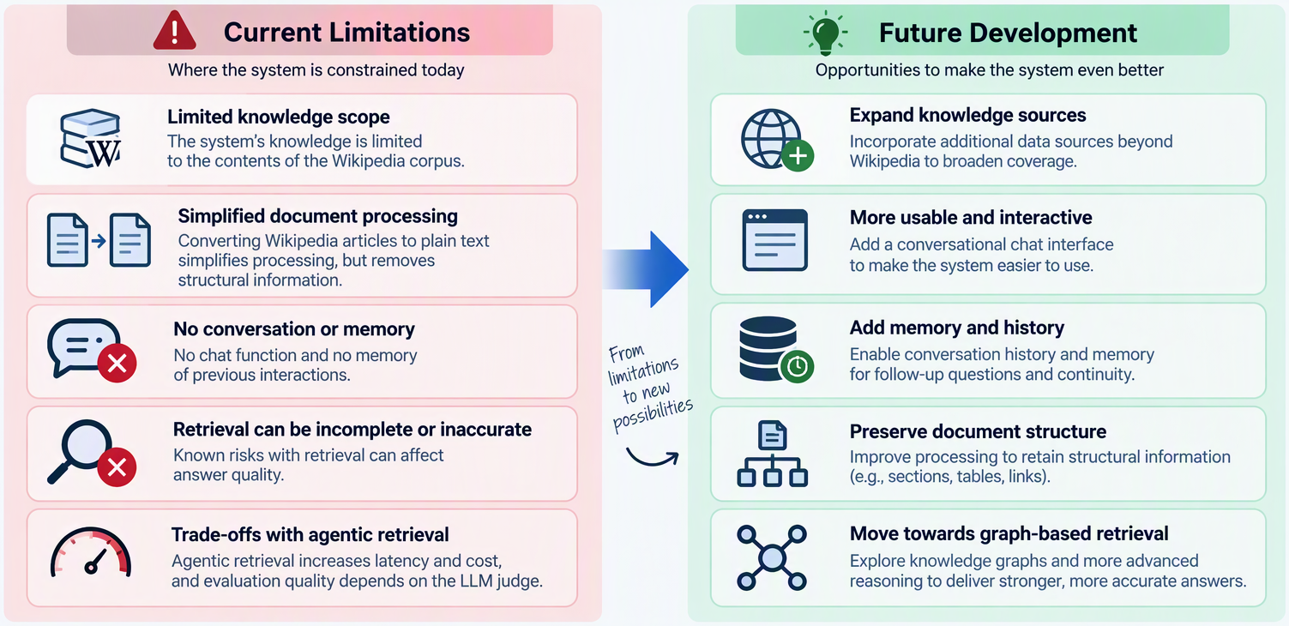
Limitations and Future Improvements
Notes:
Limits
Despite the improvements in retrieval and evaluation, the system remains limited by the information available in the Wikipedia corpus and the quality of retrieved evidence. E.g. We cannot make sure that the information
contained in the articles are always valid and 100% correct.
Converting articles to plain text simplified processing but removed structural relationships between documents, reducing opportunities for deeper relationship-based reasoning.
Additionally, the system currently operates on single-turn queries and cannot maintain conversational context or remember previous interactions.
Risks
The primary risk is that incomplete or inaccurate retrieval can still affect answer quality, even when safeguards are in place.
The agentic retrieval process also increases latency, token usage, and operating costs as additional searches and evaluations are performed.
Finally, evaluation quality depends on the consistency of the LLM judge, meaning some edge cases may still be assessed imperfectly.
All in all:
While the system became more reliable through hybrid retrieval, agentic reasoning, and evaluation, it still depends heavily on corpus quality and retrieval performance.
The next stage of development would focus on improving usability and retrieval depth. The highest priority would be adding a conversational chat interface with memory and
history, allowing users to ask follow-up questions and maintain context across interactions. Beyond this, preserving more document structure could support graph-based
retrieval and stronger relationship reasoning, while expanded evaluation datasets and retrieval optimization could further improve accuracy, efficiency, and overall user
experience.
If I were continuing this project, my first priority would not be a new retrieval algorithm but improving the user experience through a chat interface with conversational memory.
Currently, each question is treated independently. Adding history and context awareness would make the system feel much more like a real assistant. After that, I would
investigate preserving document relationships and potentially introducing graph-based retrieval to support more advanced reasoning tasks.
Beyond that, preserving article relationships and exploring graph-based retrieval would be the next major technical enhancement.

Slide 11
Questions
Thank you!
Be prepared to discuss:
Design rationale
Evaluation evidence
Engineering trade-offs
.

